Slide 1
Tutorial # 3

Slide 2

Q1: 3 missionaries and 3 cannibals
never leave a group of missionaries outnumbered by cannibals
one canoe
Problem formulation.
State space.

Slide 3
Q1.1: Problem formulation
State
  It is represented by the following structure [(i, j, k) (i’, j’, k’)].
Initial State
  [(3, 3 ,1) (0,0,0)] i.e. all in Left bank of the river.
Successor Function
  Generate new state by applying one of the actions → (move 1C), (move 2C), (move 1C+1M), (move 1M), or (move 2M).
Goal State
  [(0, 0, 0) (3,3,1)] i.e. all in Right bank of the river.
Path Cost
  Number of crossing.
Notes:
i= number of missionaries on left bank
i’= number of missionaries on right bank
j= number of cannibals on left bank
j’= number of missionaries on right bank
k= number of canoe on left bank
k’= number of canoe on right bank
the representation of the canoe has no effect and not necessary for solving the problem but the side it is in at each time is necessary for applying actions. so either you represent this information and use the actions you defined or you don’t represent it in which case you have to specify early your actions.

Slide 4
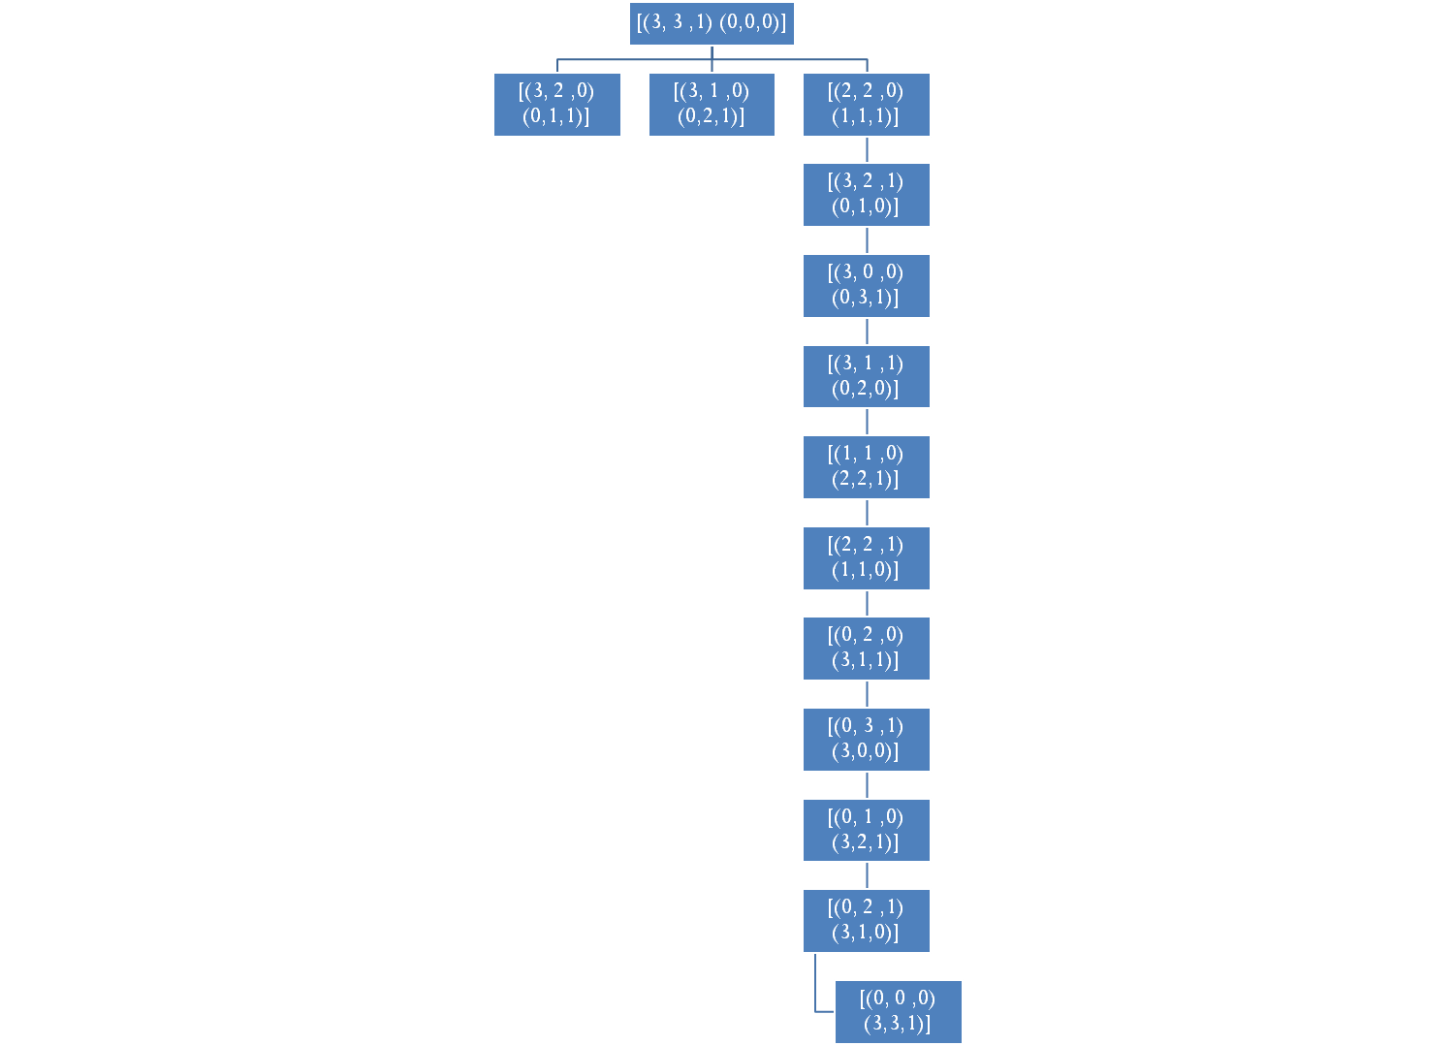
Q1.2: State space
.
.
.
.
.
.
.
.
.

Slide 5

Q2: Recursive implementation of DFS
Function DEPTH-FIRST (N)
Begin
IF N=Goal Then
Return (“Found”)
Else
For C in CHILDREN (N) DO
DEPTH-FIRST (C)
Return (“Not Found”)
End

Slide 6
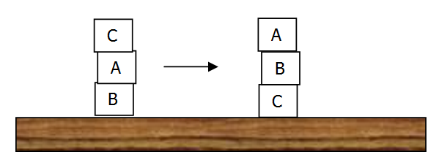
Q3: Block world problem
A block can be grasped only when its top is cleared
1 block at a time
put on the table or other block
find a plan for rearranging a stack of blocks

Slide 7
Q3.1: Problem formulation
State
  It is represented by the arrangement of the boxes(placement of A, placement of B, placement of C)
Initial State
  (b, table, a).
Successor Function
  Generate new state by applying one of the actions → put free box on a table or on another box.
Goal State
  (b, c, table).
Path Cost
  Number of moves.

Slide 8
Q3.2: State space
(c, a, t)
(t, a, b)
(b, t, a)
(c, t, t)
(t, a, t)
(b, t, t)
(t, t, t)
(t, t, b)
(t, c, t)
(t, t, a)
(c, t, b)
(b, c, t)
(t, c, a)

Slide 9

Three jugs problem
fill up or empty
empty them out
fill one to another
18
8
3
measure out exactly one gallon

Slide 10
Jug’s problem formulation
State
  It is represented by # of gallons in a jug (# of gallons in first jug, # of gallons in second jug, # of gallons in third jug)
Initial State
  (0, 0, 0).
Successor Function
  Generate new state by applying one of the actions → empty jug , fill jug or fill jug with another.
Goal State
  Reach one of the following states (1, 0, 0) , (0, 1, 0) or (0, 0, 1)
Path Cost
  Number of emptying/filling.

